Slide 1
Agile and Scrum Process Workflow
Navigating Project Success with Agile Methodologies
Vishwas Malik
04.06.2024

Slide 2
Agile Overview
Agile is an iterative approach to project management and software development that helps teams deliver value to their customers faster and with fewer headaches. An Agile team delivers work in small, but consumable, increments.

Slide 3
Scrum Framework
Scrum is a framework within which people can address complex adaptive problems, while productively and creatively delivering products of the highest possible value. Scrum comprises Scrum Teams and their associated roles, events, artifacts, and rules.

Slide 4
Scrum Roles
1. Product Owner: Represents the stakeholders and prioritizes the product backlog.
2. Scrum Master: Facilitates Scrum processes, removes impediments, and ensures the team follows Agile practices.
3. Development Team: Self-organizing group responsible for delivering potentially shippable increments of product.

Slide 5
Scrum Events
1. Sprint: A time-boxed period (typically 2-4 weeks) where a potentially shippable product increment is created.
2. Sprint Planning: Meeting to define the sprint goal and select backlog items to work on.
3. Daily Scrum: A 15-minute daily meeting for the team to synchronize activities.
4. Sprint Review: Meeting at the end of the sprint to inspect the increment and adapt the product backlog.
5. Sprint Retrospective: Meeting after the Sprint Review to reflect on the process and identify improvements.

Slide 6
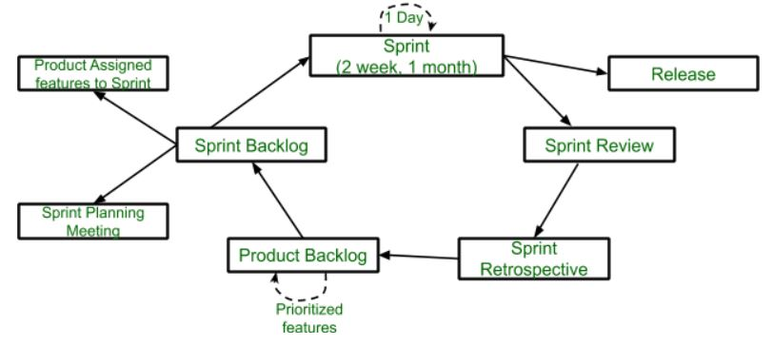
Agile and Scrum Workflow

Slide 7
Hypothetical Project: Project TechAura
Project TechAura aims to develop a new e-commerce platform. The Scrum team will deliver increments of the platform in 2-week sprints, starting with core functionality. Regular reviews and retrospectives will ensure continuous improvement and alignment with stakeholder expectations.

